Slide 1
March 17, 2016

Slide 2
AGENDA:
Data Unlocked Update - Steven Glyer
Review Consortium Input - Nick Kremer
DOW Input - Nick Kremer
CTE EF Showcase - Jan Swinton & Jemma Blake-Judd
CCCAOE Update - Kari Irwin
Chancellor’s Office Update

Slide 3
Data Unlocked Update - Steven Glyer
Regional Workshops:
April 15 - Cerritos Sheraton - 103 registered, 10 places left
May 6 - Fontana IT Learning Center - 22 registered, 63 places left
May 13 - San Diego CC -37 registered, 60 places left
May 20 - LAOCRC - location TBD (NEW)

Slide 4
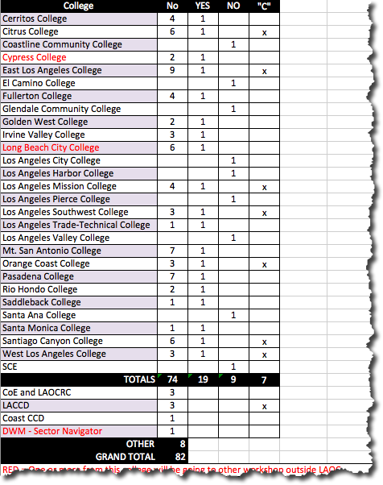
Data Unlocked Update
Handouts

Slide 5
Data Unlocked Update
April 15 Workshop Registration Summary
82 attendees from our region
21 attendees from CCCCO, IEPI and other regions
10 spaces left
19 colleges have teams
9 colleges have not signed up
7 colleges and 1 district are sending a “C” level attendee
Average of 4 attendees per college

Slide 6
Data Unlocked Update
Workshop Summary:
8:00 am - Check in and Breakfast
9:30 am - Scorecard, Tools & Resources, Technical Assistance
12 noon - lunch
12:30 pm - Hands-on Exercises
2:30 pm - break
2:45 pm - Overview
3:15 pm - Wrap Up

Slide 7
To prepare for the Workshop:
Bring at least one laptop/iPad per team
Each team must include on “C” for the am part only
Applications due June 1, 2016
Must attend workshop to access $50,000 allocation
Effective strategies for using the $50,000
Specialist/Consultant to assist colleges with planning
Bring together all colleges engaged in a specific industry to study the data
$200M will be given in part by success of your programs, thus how can this funding tackle that issue?

Slide 8
Data Unlocked Update
Key Links:
Workshop Registration - http://tinyurl.com/h2yusgf
Data Unlocked Resources for Key Talent - http://tinyurl.com/zyxpdwk
EverBrite SignUp page - http://tinyurl.com/z6fy9sx

Slide 9
Consortium Input at February Meeting - Nick Kremer
Process:
1. List of topics
2. Discussed at tables
3. Turned in notes
4. Compiled
5. Take action

Slide 10
Results
Topic | # Tables that discussed
Enhance professional development | 3
Collaboration between colleges | 3
Use of technology at meetings | 2
Work based learning | 1
Market community colleges | 1

Slide 11
NEXT STEPS

Slide 12
DOW - Nick Kremer
DOW Recommendations
JPA

Slide 13
CTE EF Showcase -
Jan Swinton & Jemma Blake-Judd

Slide 28
LA/OC Regional Vice President - Kari Irwin
Welcome new Executive Director- Elizabeth Wallner
2016 Spring Joint Conference- April 20-22, Sacramento
Early-bird registration payments due by April 1
CTE/EWD Leadership Academy- June 21-23, San Diego
Registration open, limited availability
CCCAOE visits Washington D.C.
Joyce Johnson, CCCAOE President, and Julius Sokenu, CCCAOE President Elect
www.cccaoe.org

Slide 29
Chancellor’s Office Update - Robin Harrington
Perkins
Reauthorization
2017-18 Allocations
Application Templates
http://extranet.cccco.edu/Divisions/WorkforceandEconDev/CareerEducationPractices/PerkinsIV/PerkinsIVTitleIPartC/LocalApplicationTemplates.aspx
Core Indicators
https://misweb.cccco.edu/perkins/Core_Indicator_Reports/Forms_All.aspx
Application, Quarterly, and Final Claim Reporting
Quarterly Year-to-Date

Slide 30
Chancellor’s Office Update - Robin Harrington
Renewal RFAs
Regional Consortia
Sector Navigators
Deputy Sector Navigators
TAP Centers for Excellence
WIOA
Final State Guidelines
https://www.doleta.gov/wioa/docs/WIOA_State_Plan_ICR_OMB_Passback_Plus_Supplement.pdf
State Guidance on Regional Plans

Slide 31
Chancellor’s Office Update - Robin Harrington
Strong Workforce Program
Current Information
Briefings (Trailer Bill, SB 66 & AB 1892)
Slides can be found here: PDF|PPTX
March 17th 2-3 p.m. Phone 888.886.3951 4523221
March 18th 10-11 am. Phone 888.886.3951 3559195
Questions

Slide 32
Announcements

Slide 33
April Program Approval Cycle
Apps Due - Tuesday, April 5, 2016
Voting Window - April 12-19
PA Meeting (conf call) - April 28
April Consortia Meeting
Thursday, April 21, 2016
Joint meeting of CEOs, CIOs, CSSOs and CTE Deans

